Slide 1


JetBlue Airlines Sentiment Analysis
ETL Data Processing Pipeline
DSCI-6007-02
Team 3

Slide 2
OUR TEAM
Yaw Nimo-Agyare (Data Extraction and Source Arrangements)
Rajinikanth Boini (Data Processing and Handling)
Rohit Singh (Data Visualization and Story Telling)

Slide 3

Business Problem
We are the data engineering team managing the branding for a popular airline, JetBlue. JetBlue is a leading airline that wants to understand how customers perceive their brand based on Twitter discussions. Our task is to determine public sentiment towards JetBlue and identify the key factors that drive positive or negative customer experiences.

Slide 4
Our Proposed Solution
• Develop an ETL pipeline that ingests, processes, and analyzes tweets.
• Store raw and processed data securely using AWS.
• Perform sentiment analysis to classify tweets as Positive, Negative, or Neutral.
• Use data visualization tools to present insights.

Slide 5

Data Source
Used Twitter API to fetch tweets mentioning JetBlue.
X API
https://developer.twitter.com/en/portal/dashboard

Slide 6
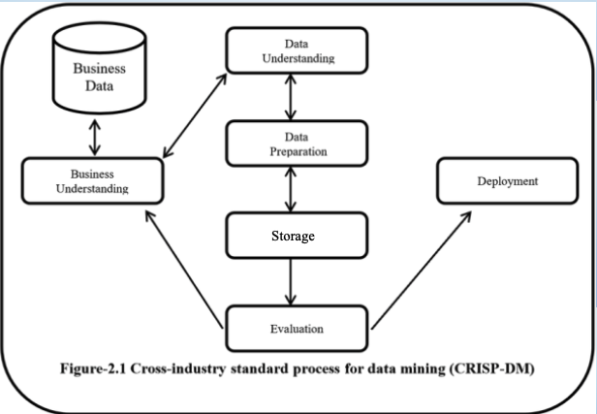
Crisp-DM Methodology

Slide 7





Tools & Project Flow
Processing
Analysis
Source
Ingestion
Storage
X API
AWS Kinesis
AWS S3

Slide 8
Summary & Next Steps
• Built an ETL pipeline for sentiment analysis of JetBlue tweets.
1
• Currently setting up AWS services for processing and storage.
2
• Next Steps: Finalize sentiment analysis model and dashboard visualization.
3

